Slide 1
統計計算 Statistical Computing
高竹嵐 Chu-lan kao

Slide 2
So… What is this course about?
This course is about some fundamental statistical computation technique that makes the modern day statistical applications possible.
We will start from classical and fundamental techniques, and move towards more modern tools based on our progress.
You will need basic knowledge on probability and statistics.
You will need to code.

Slide 3
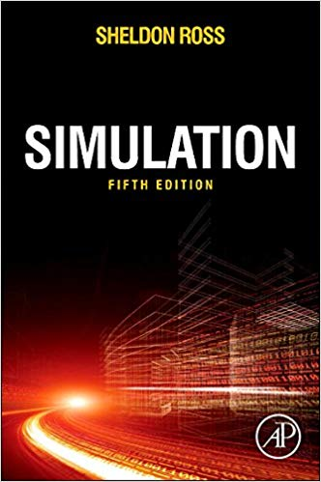

Slide 4
02/21 Chap 2. Elementary Prbability
Chap 3. Random Number Generator
02/28 No Class (二二八)
03/07 Chap 4. Generating Discrete Random Variables
03/14 Chap 5. Generating Continuous Random Variables
03/21 Chap 6. The Multivariate Normal Distribution and Copulas
03/28 Chap 7. Discrete Event Simulation
04/04 No Class (校際活動周)
04/11 Chap 8. Statistical Analysis of Simulated Data
04/18 Midterm
04/25 Chap 9. Variance Reduction Technique
05/02 Chap 10. Additional Variance Reduction Technique
05/09 Chap 11. Statistical Validation Technique
05/16 Chap 12. Markov Chain Monte Carlo Methods
05/23 Chap 12. Markov Chain Monte Carlo Methods
05/30 Chap 12. Markov Chain Monte Carlo Methods
06/06 TBA
06/13 TBA
06/20 Final
Mid-term 25%
Final 25%
Homework 40%
Class Participation 10%
Course Time: Thu 9-12 (?)
Office Hour: By appointment

